Slide 1
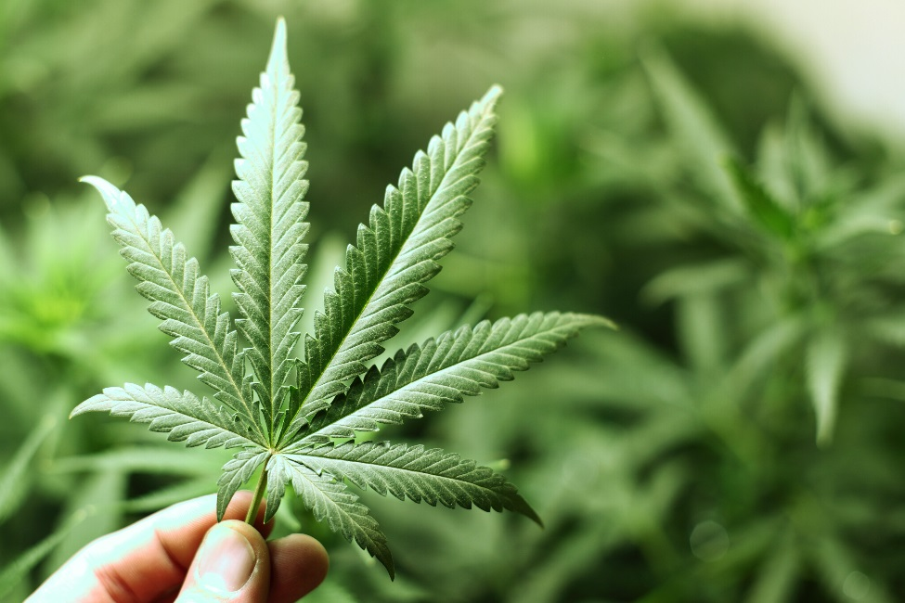
Legalized Marijuana & Workplace implications
Changing the Culture of Workplace Safety

Slide 2
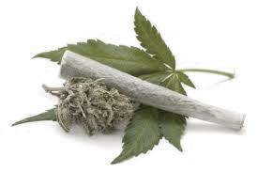
2013 U.S. Drug Use
24.6 M drug users 12 yoa + up
Marijuana = 19 Million
Non-Medical Pain Reliever = 4.5 Million
Cocaine = 1.5 Million
Hallucinogens = 1.3 Million
Methamphetamine = .5 Million
Heroin = .33 Million
http://www.samhsa.gov/data/sites/default/files/NSDUHresultsPDFWHTML2013/Web/NSDUHresults2013.pdf
Notes:
Marijuana 19 Million
N.M. Pain Relief 4.5 Million
Heroin 0.33 Million
Meth 0.5 Million
Hallucinogen 1.3 Million
Cocaine 1.5 Million

Slide 3
Illicit Drug Use by Employees
9.1% of F/T employees are illicit drug users
13.7% of P/T employees are illicit drug users
http://www.samhsa.gov/data/sites/default/files/NSDUHresultsPDFWHTML2013/Web/NSDUHresults2013.pdf

Slide 4
Quest Diagnostics Drug Test Index™
http://www.questdiagnostics.com/home/physicians/health-trends/drug-testing
Notes:
Quest Diagnostics’ Drug Testing Index showed that in 2013, positive results for marijuana increased 6.2%. Marijuana positivity rates were dramatically higher in the two states with legal recreational marijuana: marijuana positivity rates increased 20% in Colorado and increased 23% in Washington. Quest Diagnostics Drug Testing Index. (2014, September 11). Workforce drug test positivity rate increases for the first time in 10 years, driven by marijuana and amphetamines, finds Quest Diagnostics Drug Testing IndexTM analysis of employment drug tests. Madison, NJ: Quest Diagnostics. Available: http://www.questdiagnostics.com/home/physicians/health-trends/drug-testing

Slide 5
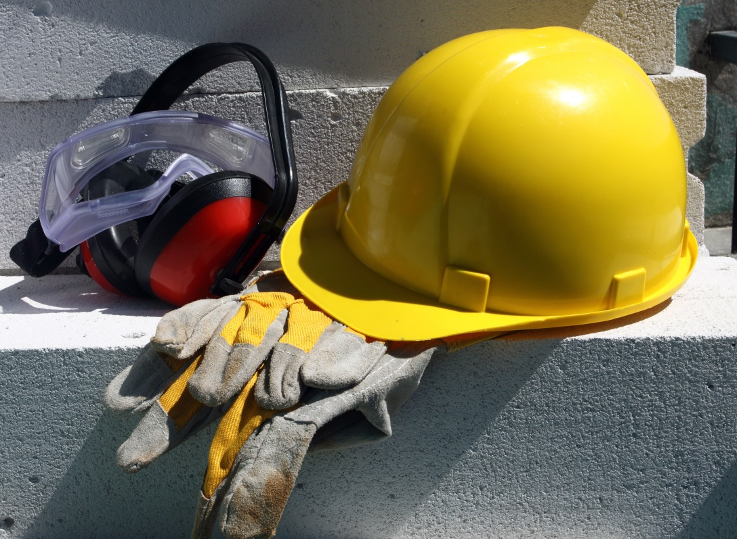
Workplace Drug Use
55% more accidents
82% more injuries
Greater absenteeism & loss of productivity
$7,000/month in lost revenue
Over $1 Billion Annually
http://www.samhsa.gov/data/trends/htm DHHS: Testimony on Federal Workplace Drug Testing

Slide 6
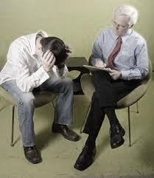
COSTS, RISKS, OUTCOMES
Substance Abuse costs the U.S. $193 Billion per year
(this does not include costs associated with domestic violence of child abuse)
1 in 10 people over 12 yoa addicted to marijuana
2nd primary reason for addiction treatment behind alcohol
3 – 5x the carcinogenic impact as cigarettes
2nd hand impact is as yet unknown due to lack of studies
http://www.justice.gov/archive/ndic/pubs44/44731/44731p.pdf
http://www.samhsa.gov
Notes:
The Drug Abuse Warning Network which shows emergency department admissions increasing from 16, 251 in 1991 to over 461,028 in 2012 (SAMHSA, 2013). Marijuana-related admissions to hospital Emergency Rooms account for more than all other drugs combined.

Slide 7
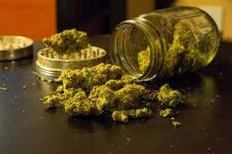
What Does Schedule 1 Controlled Substance Mean?
There is a high potential for abuse
Lack of any accepted medical use
No accepted safety standards for use
under medical supervision
Unable to regulate dosing standards

Slide 8
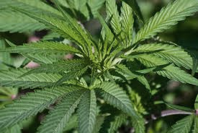
Marijuana Dependence Syndrome
18% of people aged 12 and older entering drug abuse treatment programs reported marijuana as their primary drug of abuse
Marijuana accounted for 4.5 million of the estimated 7.1 million Americans dependent on or abusing illicit drugs
61% of persons under 15 reported marijuana as their primary drug of abuse
http://www.drugabuse.gov/publications/marijuana-abuse/marijuana-addictive

Slide 9
Signs of Physiological Addiction
Restlessness
Anxiety
Anger
Paranoia
Increased sensitivity & reactivity
Increased Irritability
Decreased Appetite & Weight Loss
Aggression
Psychosis – Loses touch with reality
Difficulty falling asleep & staying asleep
Nightmares & strange dreams

Slide 10
American Psychiatric Association
“There is no current scientific evidence that marijuana is in any way beneficial for the treatment of any psychiatric disorder. In contrast, current evidence supports, at minimum, a strong association of cannabis use with the onset of psychiatric disorders. Adolescents are particularly vulnerable to harm, given the effects of cannabis on neurological development.”
American Society of Addiction Medicine
“ASAM asserts that cannabis, cannabis-based products, and cannabis delivery devices should be subject to the same standards that are applicable to other prescription medications and medical devices and that these products should not be distributed or otherwise provided to patients unless and until such products or devices have received marketing approval from the Food and Drug Administration. ASAM rejects smoking as a means of drug delivery since it is not safe. ASAM rejects a process whereby State and local ballot initiatives approve medicines because these initiatives are being decided by individuals not qualified to make such decisions.”
American Medical Association
“Our AMA discourages cannabis use, especially by persons vulnerable to the drug’s effects and in high-risk situations; supports the determination of consequences of long-term cannabis use through concentrated research, especially among youth and adolescents; believes that cannabis is a dangerous drug and as such is a public health concern.”

Slide 11
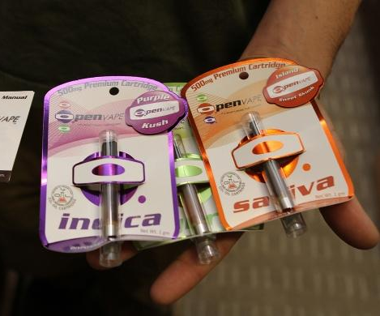
TODAY’S MARIJUANA
Higher THC than we’ve ever seen before
New delivery systems that are beyond our standard thinking
Longer lasting impairment
Confusing lack of standards regarding how to handle private use by employees
Edible products complicate the issue
Notes:
Why are we constantly talking about marijuana?
Because the properties and effects of marijuana are evolving so quickly that the professional world must work very hard to stay abreast of the facts, nuances and the scientific studies allowing us to learn more each day about what we are really dealing with. Let’s take these issues one step at a time:

Slide 12
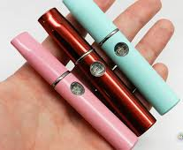
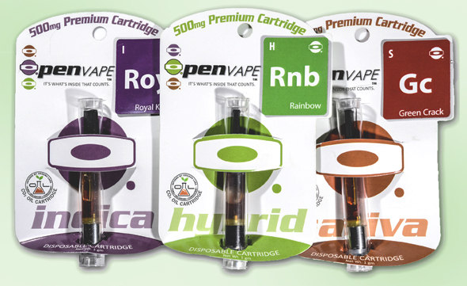
TRENDS
Notes:
The introduction of vaporizers to the marijuana market has allowed a revolution of new thinking in public consumption. The sophisticated products allow employees, students and people in the general public to consume concentrated hash oil virtually without notice. There is little to no obvious odor depending upon the sophistication of the product. Some companies are considering policies that are consistent with non-smoking on company property, however it is the impairment that must be considered thoughtfully when determining how to handle these products and their usage by employees.

Slide 13
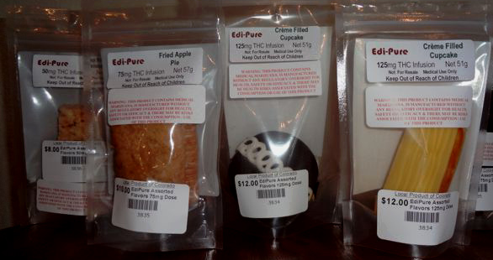
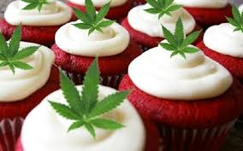
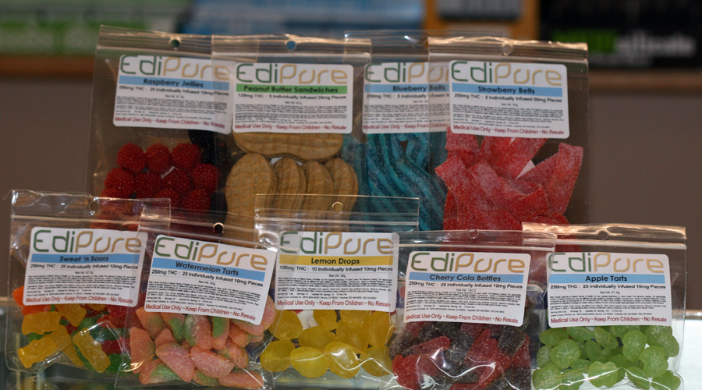
Notes:
Edibles come in an unlimited array of options that mirror foods you would see people eat every day without question.
Serving suggestions are not standardized, nor are there parameters for determining warning labels, etc.
Potency is highly variable.
Employers would have no way of knowing if an employer were to consume edibles during work hours, except for signs and symptoms of impairment which can take a little longer to manifest through the digestion system.

Slide 14
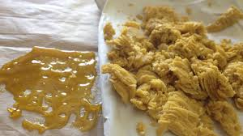

Slide 15
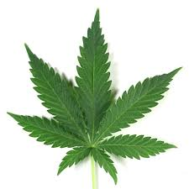
Regulating “like” alcohol
ALCOHOL
MARIJUANA
Cost $185 billion annually
$10 of loss for every $1 spent
#1 Reason for Addiction in the U.S.
Breath Alcohol Tests = blood alcohol content affecting the brain through oxygen/blood exchange
Rate of elimination from body is fairly standardized
DUI Limits standardized
Costs are as yet unknown
No limits on THC
No standardized measurement
#2 Reason for Addiction in the U.S.
Impairment has no measurement
Fat soluble – highly individualized
Impairment with stronger THC lasting for 1-3 days
Sub-acute impairment in discovery
Notes:
Treating marijuana the same as alcohol is impossible for several reasons. The potency and serving suggestions for marijuana cannot be standardized in the same way regulatory authorities have measured alcohol, due to lack of uniform measurement techniques. Additionally, there are no measurements for marijuana impairment that relate across-the-board to how we understand alcohol impairment. A simple breath alcohol test allows us to know the immediate blood alcohol ratio impacting the subject’s brain, where no such standard exists for marijuana. To be exact, no such measurement will be ready for years to come.

Slide 16
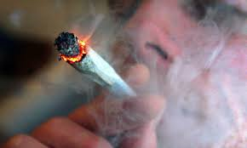
IMPAIRMENT
Short Term for Standard THC Doses:
Red eyes, strong smell; problems with memory & learning
Distorted perception, difficultly in thinking & problem-solving
Loss of physical & mental coordination in divided attention tasks
Difficulty shifting attention to meet the demands of changes in the environment, and in registering, processing and using information
Perceptual functions are significantly affected
Diminished ability to concentrate and maintain attention
Distorted time & distance tracking
Residual effects have been reported from days to weeks
http://www.nhtsa.gov/people/injury/research/job185drugs/cannabis.htm
Notes:
Red eyes, strong smell; problems with memory & learning
Distorted perception, difficultly in thinking & problem-solving
Loss of physical & mental coordination in divided attention tasks
Difficulty shifting attention to meet the demands of changes in the environment, and in registering, processing and using information
Perceptual functions are significantly affected
Diminished ability to concentrate and maintain attention
Distorted time & distance tracking
Residual effects have been reported up to 24 hours
Another Source: http://www.webmd.com/mental-health/addiction/marijuana-use-and-its-effects

Slide 17
IMPAIRMENT
Long Term for Standard THC Doses:
Fatigue, paranoia, possible psychosis, memory problems
Mood alterations, decreased motor coordination, lethargy, slurred speech, & dizziness
Impaired health – lung damage, behavioral changes, reproductive, cardiovascular & immunological effects
Respiratory problems similar to tobacco smokers , daily cough & phlegm, symptoms of chronic bronchitis. (The amount of tar inhaled and the level of carbon monoxide absorbed by marijuana smokers is 3 to 5 times greater than among tobacco smokers.)
http://www.nhtsa.gov/people/injury/research/job185drugs/cannabis.htm
Notes:
Fatigue, paranoia, possible psychosis, memory problems
Mood alterations, decreased motor coordination, lethargy, slurred speech, & dizziness
Impaired health – lung damage, behavioral changes, reproductive, cardiovascular & immunological effects
Respiratory problems similar to tobacco smokers , daily cough & phlegm, symptoms of chronic bronchitis. (The amount of tar inhaled and the level of carbon monoxide absorbed by marijuana smokers is 3 to 5 times greater than among tobacco smokers.)

Slide 18
IMPAIRMENT
Short Term for Extreme THC Doses:
Extreme paranoia
Hallucinations
Delusionary behavior that can turn violent
Bursts of violence, rage
Heart palpitations, increased risk of heart attack
Anxiety, panic attacks
ER Visits – currently higher than any other substance
The “high” has been reported to last for days, as yet unknown how long impairment can last
Notes:
The Drug Abuse Warning Network which shows emergency department admissions increasing from 16, 251 in 1991 to over 461,028 in 2012 (SAMHSA)
Deaths related to MJ in Colorado: Talk about student who plunged to his death while experiencing the effect of a marijuana edible. There was no other substance in his system in a 250 panel toxicology report.
The case where a man shot his wife to death after eating marijuana candy – in a paranoid delusion – he felt he needed to protect himself from outside attackers.
USA TODAY - http://www.usatoday.com/story/news/nation/2014/05/08/marijuana-pot-edibles-thc-legalized-recreational/8463787/
WSJ - http://online.wsj.com/articles/colorado-grapples-with-risks-from-edible-marijuana-1399675707

Slide 19
Traffic Safety
http://www.drugabuse.gov/news-events/news-releases/2014/05/more-colorado-drivers-in-fatal-car-crashes-testing-positive-marijuana
http://www.nbcnews.com/health/health-news/pot-fuels-surge-drugged-driving-deaths-n22991
Notes:
A new NIAAA- and NIDA-funded study shows an increased number of marijuana-positive Colorado drivers involved in fatal motor vehicle crashes since Colorado’s legalization of medical marijuana in 2009. A similar increase was not seen in the 34 states that did not have medical marijuana laws when this study was conducted. During the same time period, there was no change in the number of alcohol-impaired drivers in fatal motor vehicle crashes in either Colorado or the 34 then non-medical marijuana states.

Slide 20
What Colorado’s Amendment 64 Says
“Nothing in this section is intended to require an employer to permit or accommodate the use, consumption, possession, transfer, display, transportation, sale or growing of marijuana in the workplace or to affect the ability of employers to have policies restricting the use of marijuana by employees.”
Notes:
Amendment 64 is very clear in that employers must not be forced to tolerate or accommodate the effects of marijuana in the workplace. This is duplicated in Colorado State Law in several areas concerning workplace safety.
Every HR person should ask themselves – which position in our company can afford impaired workers? The answer to that should be “none”.

Slide 21
What Employees Say:
It’s legal, there’s nothing you can do about it
You can’t test me, it’s against the law
You can’t punish me for something I did at home
Presence-in-system testing is unfair ~ I wasn’t high at work
It’s not mine, it’s my roommate’s
I don’t use pot, my spouse does and it gets into my hair/clothes, etc.
I only use hemp shampoo
I’ll sue you because you are violating my Constitutional Rights to get high
Notes:
As an HR professional – you are used to hearing excuses of all types.
It is no different with marijuana.
Don’t be bullied. Know the law:
Private use is legal – public intoxication/working while impaired is NOT
Colorado law says you may not take action against someone for what they do at home – as long as it does not affect the workplace. Impairment disqualifies private use. Workplace safety over-rides private activities.
2nd hand marijuana use will not show up on a confirmatory drug test result. If it’s on the test result --- it is ingested amounts.
Hemp products will not create a positive drug test unless they are impairable amounts absorbed into the skin – it would take a LOT of product to do this and it would have to contain THC. In that case – a positive is still a positive because you are looking for THC which is the psychoactive component.
Safe and Drug-Free Workplace is a federally protected employer right. Every court case to date where an employee sued over loss of work for postiive marijuana drug test results has been found in favor of the EMPLOYER.

Slide 22
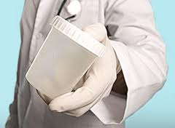
Employer’s Rights
Know Your State Laws
Employer’s Rights
Unemployment Laws
Worker’s Compensation Act
Provisions in States Where Marijuana is Legal in Some Form
Notes:
Colorado law repeatedly states that substances “present in the system” qualify for positive drug tests. While marijuana proponents decry this as unfair because it may not necessarily mean “impairment” at the time of the test – remember 3 important issues:
Presence in system testing is the only scientific method currently available. Also – every other drug test result is ALSO presence-in-system testing.
Aside from pre-employment testing – you are also using signs and symptoms of impairment and/or drug use violating safe and drug free workplaces to make your determination
In Colorado – the unsafe behaviors of an employee alone are enough to take action. While confirmatory testing is helpful – you are not bound to a decision solely based on a drug test result. Make sure your policy is very clear that erratic/unsafe behaviors are actionable.
Colorado Unemployment Law:
http://www.colorado.gov/cs/Satellite?blobcol=urldata&blobheader=application%2Fpdf&blobkey=id&blobtable=MungoBlobs&blobwhere=1251874262653&ssbinary=true
Colorado Worker’s Compensation Act:
http://www.colorado.gov/cs/Satellite?blobcol=urldata&blobheader=application%2Fpdf&blobkey=id&blobtable=MungoBlobs&blobwhere=1251874262653&ssbinary=true
Medical Marijuana Act: http://www.colorado.gov/cs/Colorado+Constitution+Article+XVIII.pdf

Slide 23
Employer’s Rights
Have a sound drug policy in place
Zero-tolerance is absolutely
Allowable & enforceable
Communicate the policy& expectations with all staff & employees
Consistently enforce policies with clarity
Keep signature pages in each employee file for proof
Notes:
Have a sound drug policy in place – check resources for good policies and have yours reviewed by an attorney WHO IS FAMILIAR with drug/alcohol policies and testing. (Just because they practice law – does not mean they know this area well)
Zero-tolerance is absolutely allowable and enforceable and is indeed the BEST practice. Attempting “case-by-case” basis is shaky ground.
Communicate the policy with all staff & employees – Either one-on-one in orientation or in mandatory all-staff training. Do not neglect to prove this has been communicated and the employee is aware.
Keep signature pages in each employee file for proof – or have a classroom/training sign-in sheet proving that the employee attended training.

Slide 24
Employer’s Rights
Pre-Employment, Post-Accident, Random & Reasonable-Cause
All supervisors should be trained in detecting signs & symptoms
Never call a Reasonable Cause test a “random”
Notes:
Pre-employment testing should be a MUST in your company. Never make a job offer without it. In 2 Colorado cases, offers were extended prior to drug test results with no contingency clause and the employee was able to successfully sue for unemployment benefits.
Post-accident testing should be a mandatory company policy with terms and parameters clearly identified. This prevents company liability should an employee cause harm or damage while impaired. It can also alleviate the amount of disability pay-outs if the employee is found at fault due to drug or alcohol impairment. A federal report on Workplace Drug-Testing by SAMHSA, states that that employees using marijuana cause 55% more accidents than those who do not and positive drug tests showing THC in the employee’s system verifies 85% more on-the-job injuries by marijuana users.
Random testing is highly recommended and the benefits far outweigh the minimal costs. Employees who use marijuana regularly have increased absenteeism, higher instances of workplace theft and loss of work productivity as additional costs to the employer. In the U.S. employee drug use costs employers over $81 billion per year in lost revenues. (SAMHSA)
Reasonable Cause testing should not be confused with random drug testing. In order to call a test “random” you must be able to prove the absolute scientific randomness of the individual being chosen for the test. So call it what it is: Reasonable Cause or Reasonable Suspicion and document it as such. Know the signs and symptoms and make sure all HR personnel and supervisory staff are also trained to detect signs of impairment.

Slide 25
Employer Responsibilities
Safe and Drug-Free Workplace
Protect employees, customers, work-environment and the public
Notes:
Know cut-off levels and what they mean
Know impairment information - DUID
Employers need to stop warning in advance for “clean” testing
Know what to look for in a policy
Know about presence in system
Know the latest in testing methods

Slide 26
Employee Assistance Programs (EAP)
Most small business owners cannot provide EAP benefits
Difficult to find affordable providers
Cost is the responsibility of the employee
Successful programs are scarce
Employees largely comply with programs when given the opportunity

Slide 27
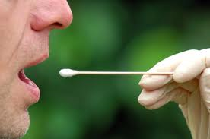
Drug Testing Ins & Outs
Since marijuana is stored in the body’s fat cells, it can be detected for up to 30 days
15 ng/mL cut-off level is standard for a positive drug test result
Before you consider increasing the cut-off level for your company, remember that 5 ng/mL is a DUID in the State of Colorado
TYPES OF TESTS
Oral Swab
Shorter detection time after use
Less problems with cheating
Lab-based confirmation needed
Urinalysis
Longer detection time after use
Lab-based confirmation needed
Hair Test
Detection window is very long. Must wait 7-10 days to detect recent use
Lab-based results only
Notes:
Quick Tests or POCT testing is an excellent way to determine immediate steps while waiting for lab test results to confirm the outcomes.
Testing can be done on-site, however it is highly recommended that your company use a TPA (Third Party Administrator) in order to prevent employees from claiming favoritism or discrimination. A TPA is a certified, trained professional that is highly skilled in drug/alcohol collections and can defend the method of testing in a court of law.

Slide 28
Where are we Headed?
The future of the marijuana pioneering spirit will continue to push all boundaries
Legalization is growing toward commercialization
Outcomes are yet unknown and will take time
Test cases will move forward that will seek to stretch the parameters of employment law
Business owners need to hold the line on safety & speak-up on rights
Notes:
The future of the marijuana pioneering spirit will continue to push all boundaries
Legalization is looking more like commercialization
Outcomes are yet unknown and will take time
Either:
Lack of regulation standards will cause issues & responses affecting public health and safety – or –
Standards will be gradually introduced in response to public health concerns that will continue to strive for balance
Efforts could eventually overturn *IF* too many violations occur – but it will take time to tell
Test cases will move forward that will seek to stretch the parameters of employment law
Employment laws in Colorado remain strongly enforced and supported

Slide 29
Legalized Marijuana & Workplace implications
Changing the Culture of Workplace Safety
Jo McGuire
jo@jomcguire.org
Five Minutes of Courage
www.jomcguire.org

