Slide 1
Persistent Cannabis Users Show Neuropsychological Decline from Childhood to Midlife
Madeline Meier, Ph.D.
Arizona State University
Duke University

Slide 2
Why Cannabis?
Timely topic
  Debate regarding the medicinal use and legalization of cannabis in the US and abroad

Slide 3


Why Cannabis?
Mixed Messages
Therapeutic
Harmful

Slide 4
The Science
Persistent cannabis use is associated with IQ decline from age 18 to 38
Placing findings in the broader context
  Links between cannabis use and
    Physical health
    Psychosis
    Socioeconomic mobility
    Workplace problems
    Relationship conflict

Slide 5
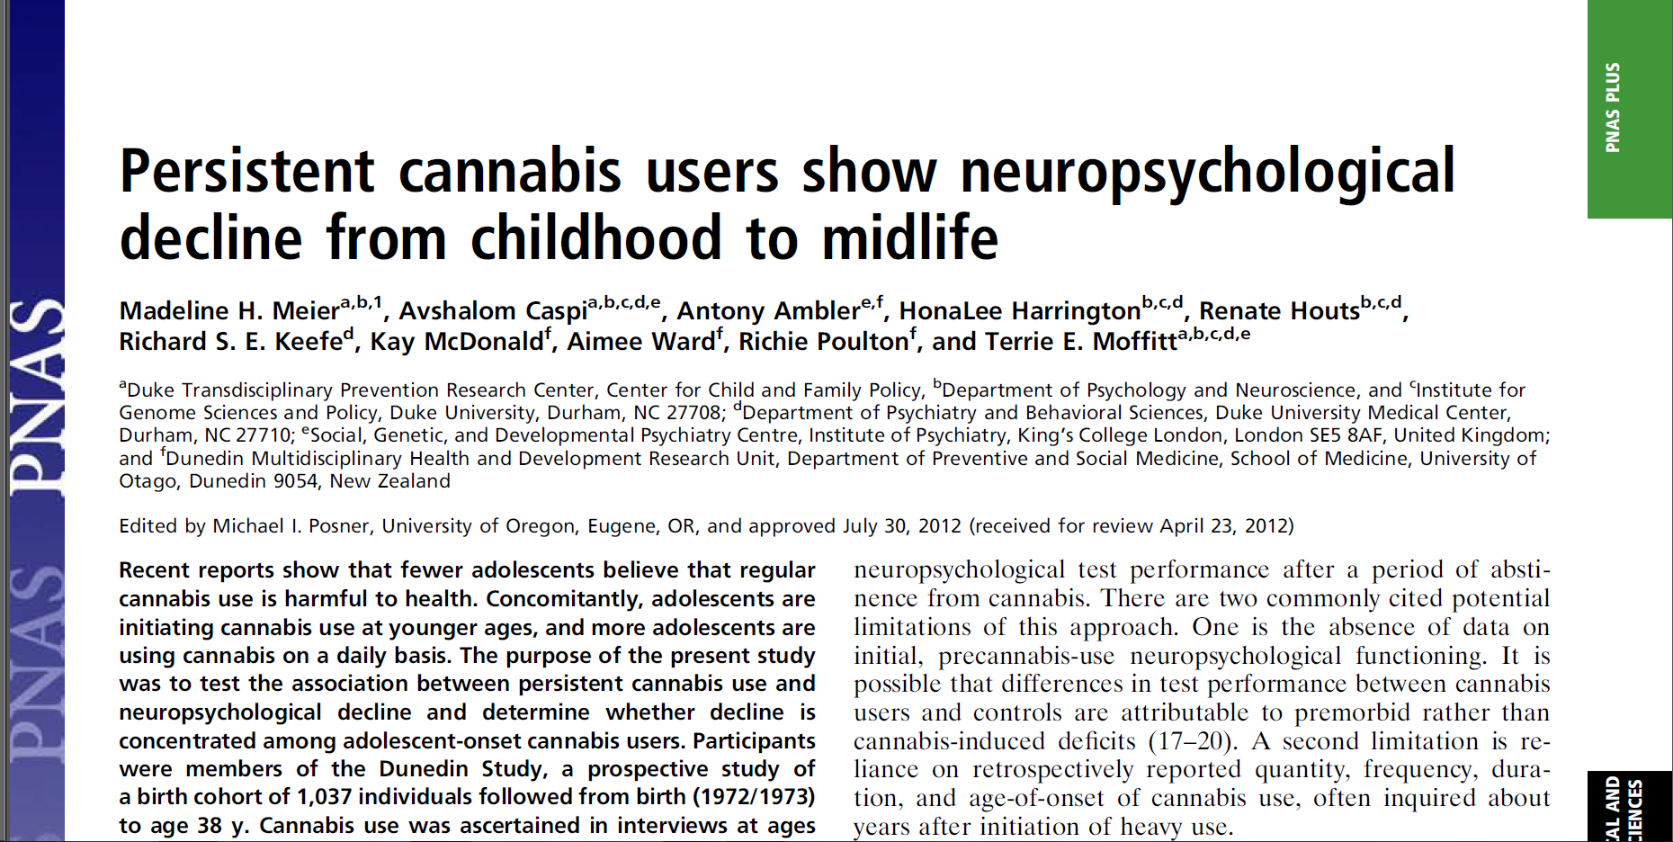

Slide 6
Rationale
Case-control studies suggest that long-term, heavy cannabis use may cause enduring neuropsychological impairment
Limitations:
  Retrospective report
  No tests of premorbid functioning

Slide 7
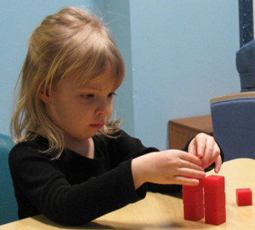


Current Study
“Before and After” IQ Testing
IQ Testing
Cannabis Assessments
IQ Testing
Ages 7-13
Age 18-38
Age 38

Slide 8
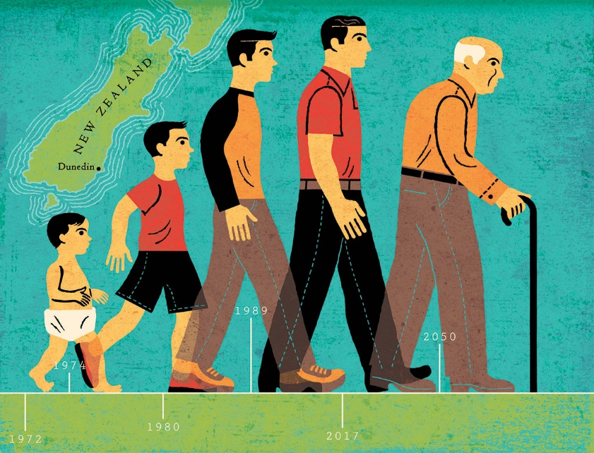
Dunedin Longitudinal Study
Age | Year | Number | Percent
Birth | 1972-73
3 | 1975-76 | 1,037 | 100%
5 | 1977-78 | 991 | 96%
7 | 1979-80 | 954 | 92%
9 | 1980-82 | 955 | 92%
11 | 1983-84 | 925 | 90%
13 | 1985-86 | 850 | 82%
15 | 1987-88 | 976 | 95%
18 | 1990-91 | 993 | 97%
21 | 1993-94 | 992 | 97%
26 | 1998-99 | 980 | 96%
32 | 2004-05 | 972 | 96%
38 | 2010-12 | 957 | 95%

Slide 9
Assessment of Cannabis Use
Cannabis dependence was assessed 5 times between ages 18 and 38
18
21
26
32
38
18
20
22
24
26
28
30
32
34
36
38
Age

Slide 10
18
21
26
32
38
18
20
22
24
26
28
30
32
34
36
38
Age
Persistence of Cannabis Dependence | N (%) | % Male
Never Used, Never Diagnosed | 242 (28) | 38.84
Used, Never Diagnosed | 479 (55) | 49.48
1 Diagnosis | 80 (9) | 70.00
2 Diagnoses | 35 (4) | 62.86
3+ Diagnoses | 38 (4) | 81.58

Slide 11
Do persistent cannabis users show IQ decline?

Slide 12
IQ Before and After Cannabis Use
Persistence of Cannabis Dependence | N | % Male | Age 7-13 Full-Scale IQ | Age 38 Full-Scale IQ | Δ in IQ
Never Used, Never Diagnosed | 242 | 38.84 | 99.84 | 100.64 | 0.05
Used, Never Diagnosed | 479 | 49.48 | 102.32 | 101.25 | -0.07
1 Diagnosis | 80 | 70.00 | 96.40 | 94.78 | -0.11
2 Diagnoses | 35 | 62.86 | 102.14 | 99.67 | -0.17
3+ Diagnoses | 38 | 81.58 | 99.68 | 93.93 | -0.38

Slide 13
Can this effect be explained by alcohol or other drug use?

Slide 14
Full Cohort
Past 24-hour
Past Week
Persistent Tobacco
Persistent Hard Drug
Persistent Alcohol
Schizophrenia
Change in Full-Scale IQ (SD units)

Slide 15
Can this effect be explained by reduced years of education among persistent cannabis users?

Slide 16
Full Cohort
High-School Education or Less

Slide 17
Can this effect be explained by low SES?

Slide 19
Full Cohort
Middle-Class Families

Slide 20
What about other mental functions?

Slide 21
Executive Function
Processing Speed
Learning
Memory
Verbal Ability

Slide 22
Do friends and relatives notice cognitive problems?

Slide 23
Informant-Reported Cognitive Problems In Everyday Life
Informant Reports | Never Used, Never Diagnosed | Used, Never Diagnosed | 1 Diagnosis | 2 Diagnoses | 3+ Diagnoses | Linear Trend T-test
Attention Problems | -0.21 | -0.07 | 0.31 | 0.64 | 0.96 | 7.74*
Memory Problems | -0.27 | -0.03 | 0.38 | 0.78 | 0.75 | 7.65*
“Is easily distracted, gets sidetracked easily”
“Forgets to do errands, return calls, pay bills”

Slide 24
Are adolescents particularly vulnerable?

Slide 25
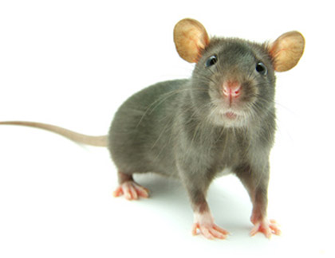
Adapted from Schneider, M. (2008). Addiction Biology, 13, 253-263

Slide 26
1 Diagnosis
2 Diagnoses
3⁺ Diagnoses

Slide 27
1 Diagnosis
2 Diagnoses
3⁺ Diagnoses
Adolescent-Onset
8-pt IQ loss
(n=17)
(n=12)
(n=23)

Slide 28
1 Diagnosis
2 Diagnoses
3⁺ Diagnoses
Adolescent-Onset
Adult-Onset
8-pt IQ loss
(n=17)
(n=57)
(n=12)
(n=21)
(n=23)
(n=14)

Slide 29
Does quitting restore functioning?

Slide 30
Quit by Age 38
(n=17)
Still Using at Age 38
(n=19)
Quit by Age 38
(n=13)
Still Using at Age 38
(n=20)
Adolescent-Onset
Adult-Onset

Slide 31
Summary
Do persistent cannabis users show IQ decline?
  Yes, but this effect is limited to adolescent-onset cannabis users
Can this effect be explained by alcohol and other drug use, reduced years of education, or low SES among persistent cannabis users?
  No
Does IQ decline translate to cognitive problems in everyday life?
  Yes

Slide 32
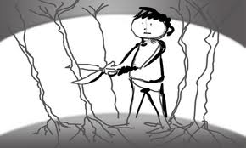
Potential Brain Implications
Adolescent brains may be especially vulnerable to cannabis
  Cannabis use disrupts critical brain development that occurs during adolescence (e.g., synaptic pruning, myelination)

Slide 33
Should we be concerned about an 8-pt IQ loss among teens?

Slide 34
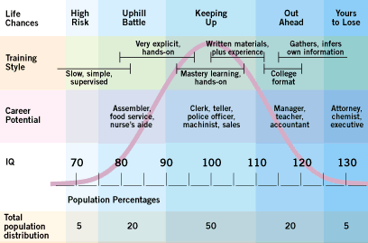
An 8-pt IQ Loss Drops A Person with Average IQ from the 50th to the 29th percentile

Slide 35
What Should We Do?
Delay the onset of cannabis use
Encourage cessation of cannabis use particularly for those who began using cannabis in adolescence

Slide 36
Putting Findings in Context

Slide 37
Do Persistent Cannabis Users Show Poorer Physical Health in Early Midlife?
New Findings

Slide 38
Age 38 Health Measures
Periodontal Health
Lung Function
Inflammation
Metabolic Health
  Metabolic Syndrome
    Waist Circumference
    Triglycerides
    HDL Cholesterol
    Blood Pressure
    Glucose Control

Slide 39
Persistent Cannabis Users Have Increased Risk of Periodontal Disease
Notes:
Not adjusted

Slide 40
Persistent Cannabis Users Do NOT Have Increased Risk of COPD
Notes:
Not adjusted

Slide 41
Persistent Cannabis Users Do NOT Have Increased Risk of High CRP (Inflammation)
Notes:
>mg/L

Slide 42
Persistent Cannabis Users Do NOT Have Increased Risk of Metabolic Syndrome

Slide 43
Persistent Cannabis Users Have Smaller Waist Circumference
Notes:
>88 cm for women >102 for men

Slide 44
Persistent Cannabis Users Do Not Have Higher Triglyceride Levels
Notes:
Ge 2.26 mmol/l

Slide 45
Persistent Cannabis Users Do Not Have Lower HDL (Good Cholesterol)
Notes:
<1.3 mmol/l for women of <1.04 for men (millimole per liter)

Slide 46
Persistent Cannabis Users Do Not Have Higher Blood Pressure

Slide 47
Persistent Cannabis Users Do Not Have Higher HbA1c (an index of poor glucose control)
Notes:
Expressed as % of total hemoglobin; ge 5.7%

Slide 48
Summary
Adolescent-onset persistent cannabis use is associated with IQ decline
Persistent cannabis use is NOT associated with poorer physical health

Slide 49
Summary of Other Dunedin Study Findings
Finding | Reference
Cannabis use is associated with psychosis | Arsenault et al., 2002, BMJ
Cannabis use is associated with periodontal disease | Thomson et al., 2008, JAMA
Cannabis use is NOT associated with poor lung function | Hancox et al., 2010, Eur Respir J
Cannabis use is associated with downward socioeconomic mobility, financial difficulties, workplace problems, and relationship conflict | Cerda et al., under review

Slide 50
Acknowledgements
Terrie Moffitt
Avshalom Caspi
HonaLee Harrington
Renate Houts
Richie Poulton
Dunedin Study Team
UK Medical Research Council Grants G0100527 and MR/K00381X/1
US National Institute on Aging Grant AG032282
US National Institute on Drug Abuse Grant P30 DA023026

