Slide 1
Marijuana
Parents360
Notes:
Welcome to the Parents 360 presentation on Marijuana.
At today’s event, we’re going to take a look at what is marijuana, what are the current trends around marijuana use and why you as a parent are so important in preventing marijuana use with your children.

Slide 2
What is Marijuana?
Marijuana is the most commonly abused illicit drug in Arizona.
It is a dry, shredded green, brown or gray mix of flowers, stems, seeds and leaves from the hemp plant, Cannabis sativa.
The main active chemical in marijuana is delta-9-tetrahydrocannabinol, or THC for short.
Notes:
So – what is marijuana?
Marijuana is the most commonly abused illicit drug in Arizona.
It is a dry, shredded green, brown or gray mix of flowers, stems, seeds, and leaves from the hemp plant Cannabis sativa.
The main active chemical in marijuana is delta-9-tetrahydrocannabinol, or THC for short. THC is the main psychoactive – mind altering chemical in marijuana, but there could be any number of about 400 other chemicals, in marijuana, that could affect a person’s health.
As you will see, Marijuana’s strength or potency is related to the amount of THC it contains and the THC content of marijuana has been increasing since the 1970s.

Slide 3
Marijuana Slang/Street Names
Pot
Ganja
Herb
Weed
Mary Jane
Grass
Chronic
And more than 200 others
Different strains of marijuana have their own “brand” names
Notes:
There are a lot of different terms for marijuana – some of the most common are:
Pot
Ganja
Herb
Weed
Mary Jane
Grass
Chronic
And more than 200 others
In recent years, marijuana has been manipulated to make it more potent, and different strains of marijuana, now have their own “brand” names.

Slide 4
How is it Abused?
Marijuana is usually smoked
  As a cigarette (joint)
  In a pipe or water pipe (bong)
  In “blunts,” which are cigars that are hollowed out and refilled with a mixture of marijuana and tobacco
Marijuana can be mixed in food or brewed as a tea – made into food (edibles)
Marijuana can be combined with other drugs such as PCP
Notes:
Marijuana is usually smoked as a hand-rolled cigarette, which is usually called a joint. It can be smoked in a pipe or water pipe, which is called a bong, or in “blunts,” which are cigars that are hollowed out and refilled with a mixture of marijuana and tobacco.
Marijuana can be mixed in food or brewed as a tea. Marijuana now comes in a edible form which is basically food items containing marijuana.
Marijuana can be mixed in food, brewed as a tea, and is often combined with other drugs, such as PCP.

Slide 5
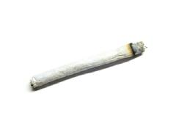
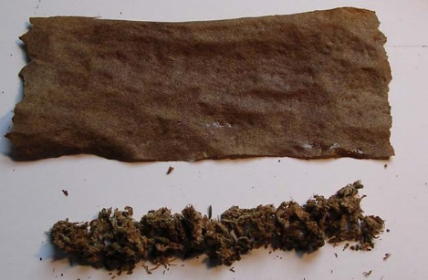
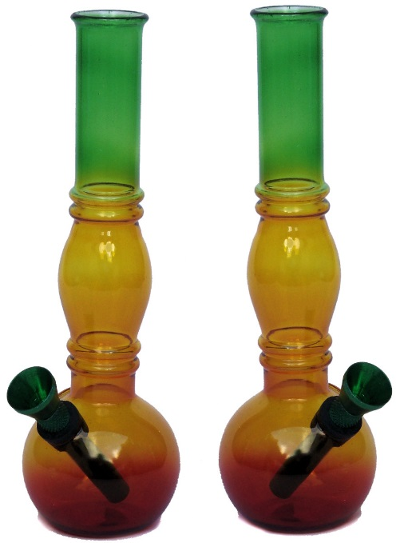
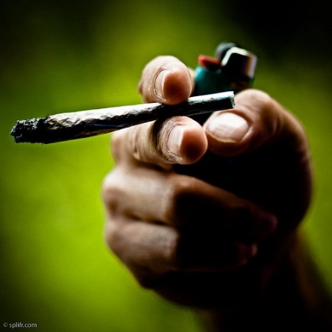
What it looks like
Notes:
Here are some examples for you. There are two photos of joints, the photo in the middle is a blunt where the tobacco has been taken out of the cigar and will be replaced with a mix of marijuana and tobacco or just marijuana. In the last photo are two bongs used to smoke marijuana.

Slide 6
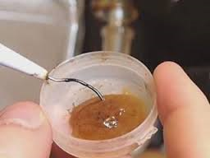
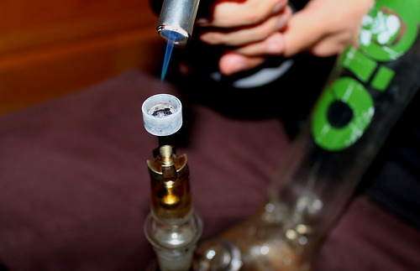
New Trends - Dabbing
Hash oil
Budder
Honey Oil
Wax or Ear Wax
Shatter
1 dab = 5 joints*
*420times.com
Notes:
There are some new trends in marijuana use.
The newest is called dabbing. Dabbing is a process where the pure hash oil is extracted from the marijuana plant and made into a wax like substance. Some slang names for the dab includes Budder, Honey Oil, Wax or Ear Wax.
The dab is smoked in a pipe, vaporizer or e-cigarette type device
This wax type of marijuana can include up to 90 percent THC in the formula. In short, it's highly hallucinogenic. *from join together.com
One dab is equal to about 5 joints.

Slide 7
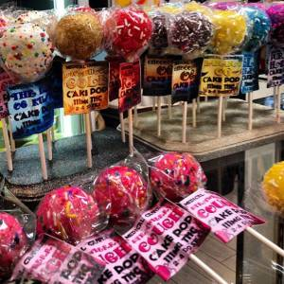
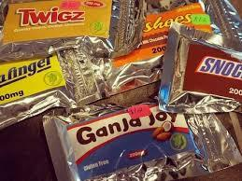
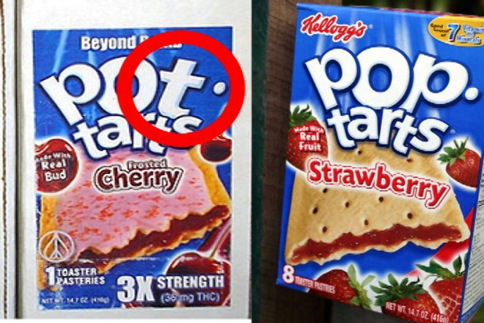
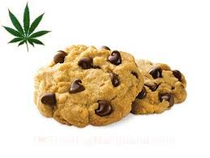
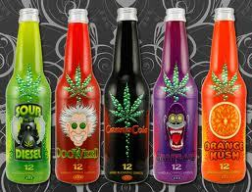
Today’s Marijuana
Notes:
As referred to in the earlier slide these are marijuana products you can eat called edibles.
There are Pot Tarts, Suckers, Candy Bars, cookies and sodas that contain marijuana. Who do you think these edibles would be attractive to?
Answer = Our kids.

Slide 8
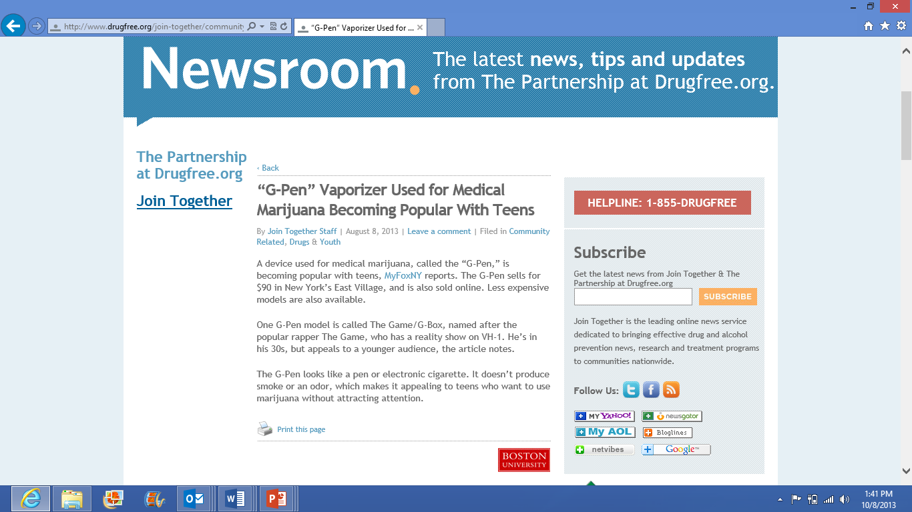
New Trends – Vaporizers
Notes:
This is news about vaporizers becoming popular with teens. Vaporizers are used for medical marijuana but are becoming popular with youth because when you smoke it, it doesn’t produce smoke or odor.

Slide 9
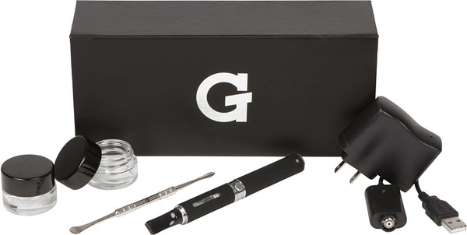
Vaporizers, e-Cigarettes
Notes:
News reports are now beginning to come out reporting that people are smoking marijuana out of e-cigarettes. Marijuana in liquid and wax forms used in e-cigarettes and vapor pens does not create an odor. Because the devices don’t produce a flame, a person smoking marijuana in an e-cigarette can take a puff and then quickly put it in a pocket. The practice is, in fact, often called “vaping” rather “smoking” due to the fact that e-cigarette users inhale a vapor, not smoke.

Slide 10
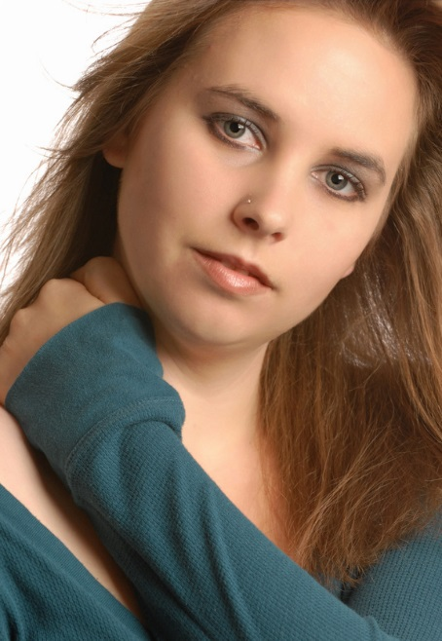
Arizona’s Story
Ever Used Marijuana
1 out of 6 8th graders
1 out of 3 10th graders
Nearly half (45%) 12th graders
Arizona Youth Survey, 2014
Notes:
Let’s take a look at how many Arizona youth have tried marijuana. About 1 out of 6 8th graders or (15%), 33% of 10th graders and nearly half of 12th graders (45%) say they have smoked pot at least once in their lifetime.

Slide 11

Arizona’s Story
Used in the past 30 days
7% 8th graders
17% 10th graders
23% 12th graders
Arizona Youth Survey, 2014
Notes:
When we look at past 30 day marijuana use, these are youth that are considered regular marijuana users. Let’s take a look at how many Arizona youth have used marijuana in the past 30 days.
7% of 8th graders.
1 out of 6, 10th graders or (17%) and nearly 1 out of 4 12th graders or (23%).

Slide 12
What is the average age of first marijuana use in Arizona?
13
Why is this important?
Arizona Youth Survey, 2012
Notes:
What do you think the average age of first marijuana use is in Arizona?
It’s just 13 years old…
And 1 out of 8 youth who use marijuana started in elementary school.
Why is this important.

Slide 13
The Brain is Uniquely Vulnerable During Adolescence
Early use is associated with the most significant impairment
Persistent marijuana users show neuropsychological decline from childhood to midlife*
National Academy of Sciences E2657-2664, 2012
Notes:
It’s important because the teen brain is very vulnerable during adolescence. Early first use, like 13 years old and elementary school is associated with the most significant impairment. Persistent marijuana users show neuropsychological decline from childhood to midlife. Please remember this slide, we’re going to come back to this.

Slide 14
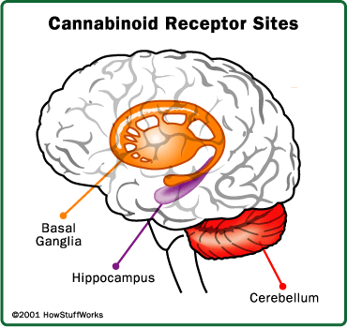
Marijuana effects the brain
THC effects specific parts of the brain called cannabinoid receptors
The parts of the brain that have the most cannabinoid receptors influence:
  Pleasure
  Memory, thinking and concentration
  Sensory and time perception
  Coordinated movement
National Institute on Drug Abuse, 2010
Notes:
THC effects specific parts of the brain, called cannabinoid receptors.
The parts of the brain that have the most cannabinoid receptors influence:
Pleasure
Memory, thinking and concentration
Sensory and time perception
Coordinated movement
Research shows that drivers on marijuana have slower reaction times, impaired judgment, and problems responding to signals and sounds.
This slide shows why marijuana prevention is so important. At a time when kids are learning and their brains are developing marijuana use can impact their chances of success in school and life.

Slide 15
Short-term Effects
Marijuana intoxication can cause:
  Reduced inhibition
  Distorted perceptions
  Impaired coordination
  Difficulty with thinking and problem solving
  Interferes with learning and memory
  Can make driving dangerous
  Causes increased heart rate
http://www.nida.nih.gov/infofacts/marijuana.html
Notes:
Our youth are using marijuana for fun (1) and to get high (2). But does anyone want to guess the other top reasons our kids are using drugs?
To deal with stress (3) and to keep from feeling sad (4)
So, what are the short-term effects of marijuana?
Marijuana can reduce inhibition, which can lead to risky behaviors, can cause distorted perceptions, impair coordination, create difficulty with thinking and problem solving and cause problems with learning and memory.
The cerebellum is the section of our brain that controls balance and coordination. THC affects the cerebellum’s function, and also affects the basal ganglia, another part of the brain that’s involved in movement control.
These THC effects can cause disaster on the road. Research shows that drivers, who have been using marijuana have slower reaction times, impaired judgment, and problems responding to signals and sounds.
Within a few minutes after inhaling marijuana smoke, an individual's heart begins beating more rapidly, the bronchial passages relax and become enlarged and blood vessels in the eyes expand, making the eyes look red.
The normal heart rate of a teen usually between 70 to 80 beats per minute. Marijuana can cause the heart rate to increase by 20 to 50 beats per minute or, in some cases, even double. This effect can be greater if other drugs are taken with marijuana.

Slide 16
Marijuana Effects – After the Euphoria
Sleepy
Depressed
Occasionally marijuana use may produce
  Anxiety
  Fear
  Distrust
  Panic
Notes:
After a while, marijuana’s effect subsides, and the user may feel sleepy or depressed. Occasionally, marijuana use may produce anxiety, fear, distrust, or panic.

Slide 17
Long Term Effects and Addiction
Effects on body/health after long-term use:
  Ability to do complex tasks could be compromised
  Negative impact on pursuit of life goals
  Can contribute to lung damage
http://www.nida.nih.gov/infofacts/marijuana.html
Notes:
When people smoke marijuana for years, they can suffer some pretty negative consequences.
Ability to do complex tasks could be compromised
Negative impact on pursuit of life goals
Inability to be 100 percent focused on succeeding
Long-term marijuana users have self-reported less life satisfaction, poorer education and job achievement and more interpersonal and mental health problems compared to people who do not use marijuana.
The smoke from marijuana contains some of the same chemicals found in tobacco smoke; plus, marijuana users tend to inhale more deeply and hold their breath longer, so more smoke enters the lungs. Not surprisingly, people who smoke marijuana have some of the same breathing problems as those who smoke tobacco—they are more susceptible to chest colds, coughs, and bronchitis than people who do not smoke.

Slide 18
Marijuana is Addictive
Studies tell us
  About nine percent of users become addicted to marijuana
  Higher for those who start in their teens (17 percent or 1 out of 6)
  Even higher among daily users (25-50 percent)
Notes:
We now know that marijuana is addictive. In fact, studies tell us that about nine percent of users become addicted to marijuana. That number is higher for those who start in their teens (17 percent) or 1 out of 6 and among daily users that number grows to (25-50 percent).

Slide 19
Marijuana Withdrawal
Similar to nicotine withdrawal
  Irritability
  Sleeping difficulties
  Craving
  Anxiety
  Increase aggression on psychological tests, peaking 1 week after they last used the drug
Notes:
Marijuana addiction is also linked to a withdrawal syndrome similar to that of nicotine withdrawal, which can make it hard to quit. People trying to quit report irritability, sleeping difficulties, craving, and anxiety. They also show increased aggression on psychological tests, peaking approximately 1 week after they last used the drug.

Slide 20
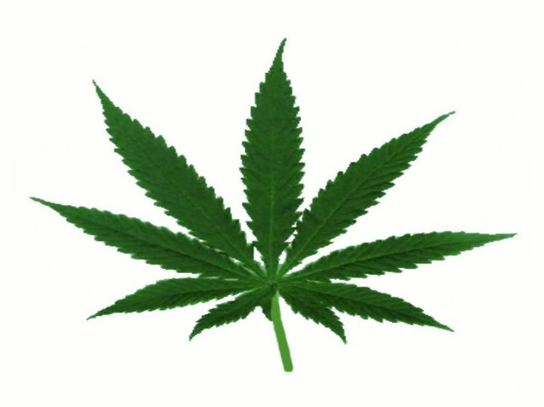

Marijuana and IQ
IQ
Proceedings from the National Academy of Sciences Vol. 109 no:40
Notes:
Remember the earlier slide where it said that teen brains are uniquely vulnerable to marijuana use. The National Institute for Drug Abuse found that people who started using marijuana as teenagers, by the time they were 38, they lost about 8 IQ points. That puts a person of average intelligence into the lowest third of the intelligence range. This can jeopardize our children’s chances of success in school and life.

Slide 21
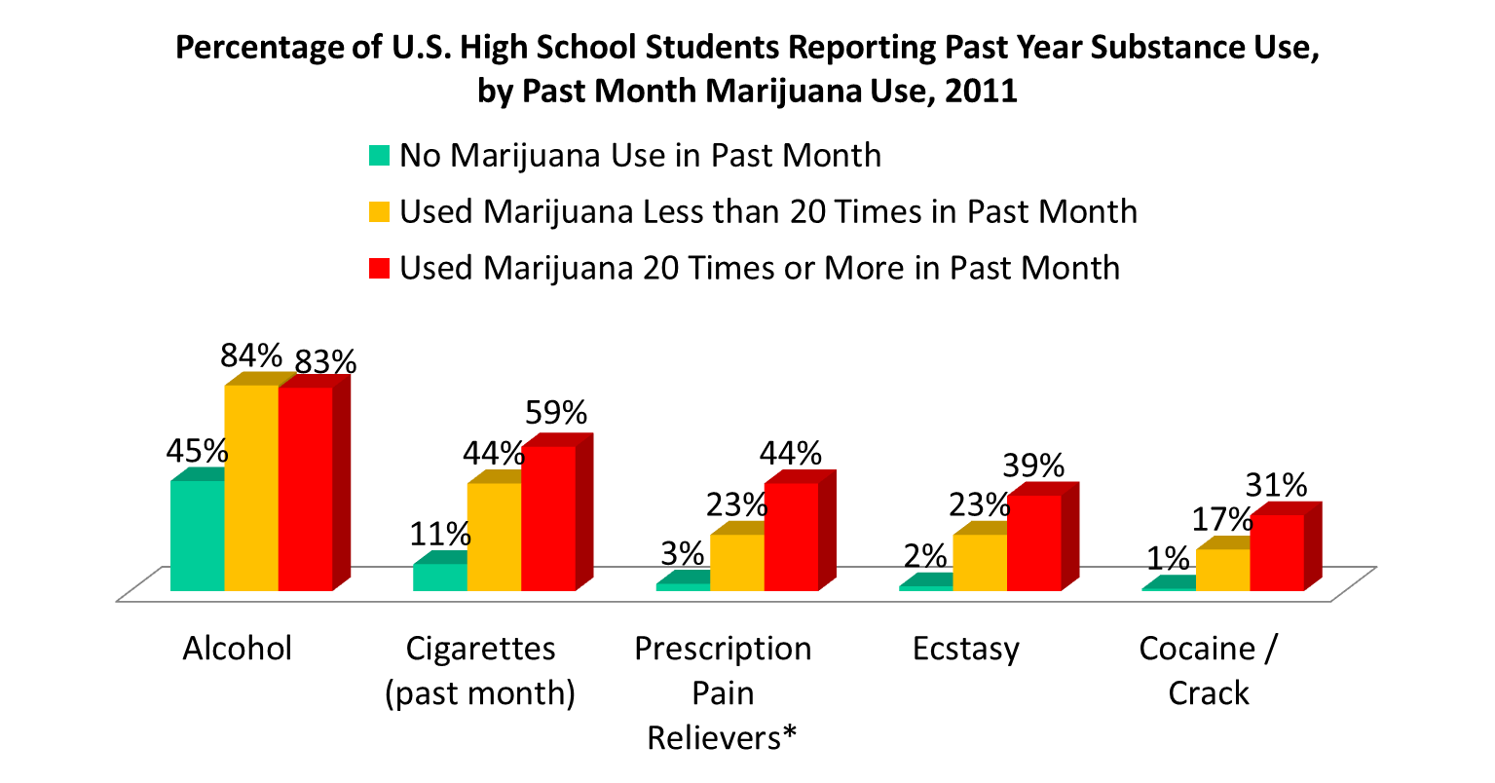
Marijuana and Other Drugs
PATS, 2011
Notes:
The reality is that kids who are regular users of marijuana are much more likely to use other drugs such as alcohol, cigarettes, prescription pain relievers, and cocaine, as well as all other drugs of abuse not listed here such as meth, inhalants and cough medicine. Further, the more they use, the more likely they are to use these other drugs. You don’t need to accept or reject the idea of marijuana as a “gateway” to other drugs to recognize that kids who are using marijuana on a heavy, consistent basis, are much more likely to be using other drugs of abuse as well. We can’t say “it’s just pot,” and not worry.

Slide 22
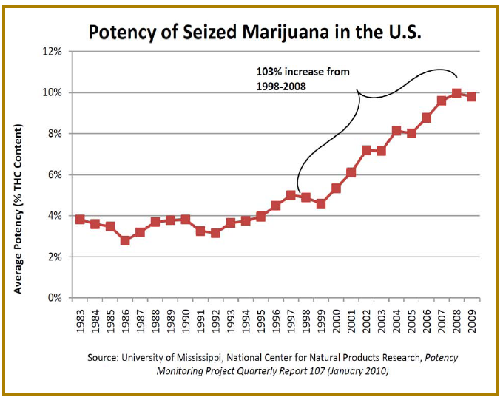
Marijuana Potency
Notes:
Marijuana has changed a lot over the decades and one of the biggest changes is in its strength or potency. This graph shows us how the strength or potency of marijuana more than doubled between 1998 and 2009.

Slide 23
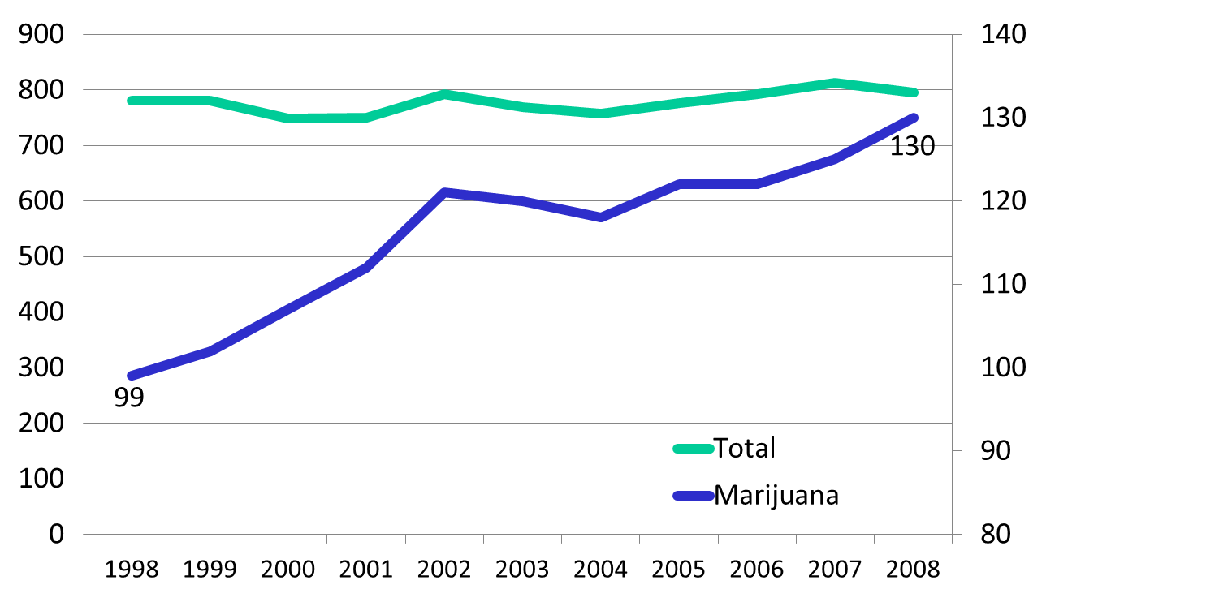
Marijuana Treatment Admissions
TOTAL ADMISSIONS
MARIJUANA ADMISSIONS
Treatment Admissions per 100,000 population, TEDS, SAMHSA, 2010
Notes:
… and look what happened. Along with increased potency more people needed help to quitting. This graph shows treatment admissions for marijuana. They increased 30 percent, while overall treatment admissions for other drugs remained roughly constant.

Slide 24

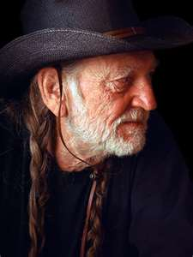
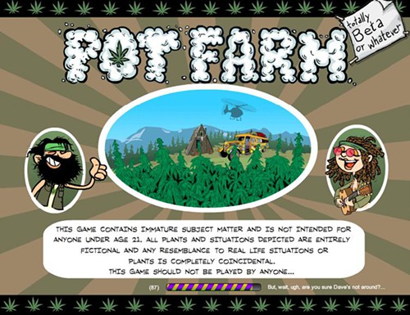


Media & Marijuana
Notes:
While the science has never been clearer that marijuana is not a harmless drug, there seems to be a huge disconnect.
So where is this disconnect coming from?
Well, if you use online social media [CLICK ANIMATION], watch movies [CLICK], listen to music [CLICK] for old people or young people [CLICK] or watch TV, you will see marijuana use treated as a harmless, if not displayed as positive or fun behavior.

Slide 25
Where kids get it
3 out of 4 youth get pot from friends
1 out of 4 get pot at parties
1 out of 10 got marijuana at school
About 1 out of 7 get marijuana from someone with a medical marijuana card
Arizona Youth Survey, 2014
Notes:
Other than alcohol, marijuana is one of the most available drugs in Arizona.
Most youth get their marijuana from these sources.
3 out of 4 get marijuana from Friends (75%) – Why is this important. If your child’s friends smoke pot, your child is more likely to try it.
Parties 1 out of 4 (27%)
School 1 out of 10 get marijuana at school (11%)
And about 1 out of 10, (14%) 8th, 10th and 12th graders get marijuana from someone with a medical marijuana card

Slide 26
Medical Marijuana
There is no medical grade marijuana
  The marijuana sold in a dispensary is the same marijuana sold on the street and carries the same health risks
Marijuana has not gone through the FDA process that every other medication has
Marijuana is recommended not prescribed
Notes:
We want to take just a minute to touch on medical marijuana. How many of you know the difference between medical marijuana and marijuana found on the streets?
Did you know that there is no medical grade of marijuana. That the marijuana sold in the dispensary is the same marijuana sold on the streets.
Some of the ingredients in marijuana, such as THC (delta-9-tetrahydrocannabinol), have medicinal effects. And some people say they get relief from symptoms of their illnesses by smoking marijuana. However, using marijuana as medicine does not make it medicine. It has not gone through the FDA approval process to show that its benefits outweigh its risks.
Also marijuana is not prescribed, those who get it receive a recommendation for it.

Slide 27
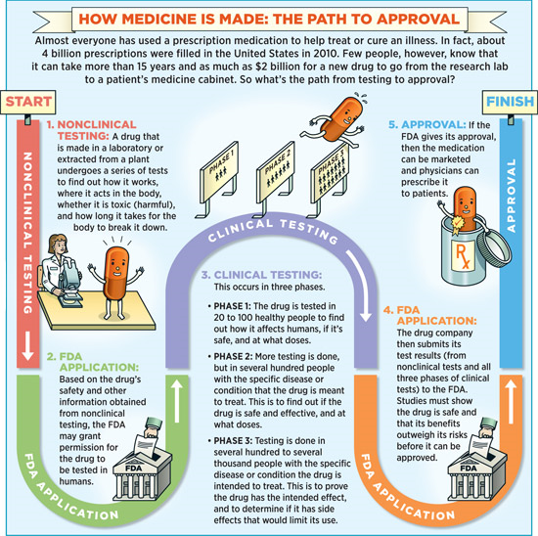
Notes:
This is the process for medicine to be approved in the United States.
It can take more than 15 years and as much as 2 billion dollars for a medicine to be approved and this is its process.
It starts with nonclinical testing and the FDA application then it goes to clinical testing where there are 3 phases. Next is the FDA application where the FDA looks to ensure that the benefits outweigh any health risks and then the drug gets approved.
Although marijuana has not gone through this process, there are some medications that do contain THC. Marinol® is synthetic THC made into a pill. It is FDA-approved to relieve nausea and vomiting in cancer patients undergoing chemotherapy. It is also used to reverse severe weight loss in patients with AIDS.

Slide 28
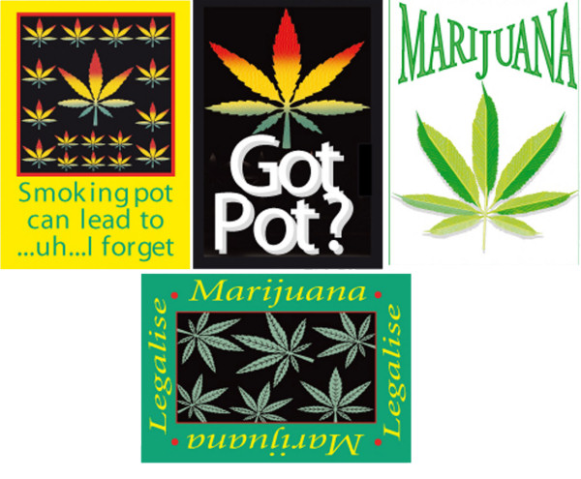
Legalization = Access
One of the biggest risk factors for youth drug use is availability
32,000* Arizona youth would be more likely to try pot if it is legalized in our state
*Arizona Youth Survey, 2012, Partnership Attitude Tracking Survey, 2012
Notes:
One of the biggest risk factors for drug use is availability. Repeated marijuana use has consequences especially for the developing brain.
If marijuana is legalized in Arizona, 32,000 youth would be more likely to try marijuana, putting their school and future at risk.

Slide 29
In Summary
Adolescence is a critical period for brain development
Adolescents are prone to risk taking
Marijuana has profound effects on brain development
Protecting our kids from marijuana use is crucial. We must take action!
Notes:
In Summary,
The Science has never been clearer. Harvard University, Northwestern, The New England Journal of Medicine are all issuing scientific reports with regard to the health harms and consequences of marijuana.
As a parent we must be clear to our youth that we do not want them using marijuana. The way we begin is with a conversation.

Slide 30
Talking with your kids about Marijuana
Focus on one goal: You do not want them to use.
Stick to simple, straightforward arguments:
  Marijuana makes it harder for your brain to make good decisions
  Marijuana reduces motivation, increases impulsivity
  For some people, once they start using marijuana, they can’t or won’t stop
  Marijuana can keep you from doing and being your best
  Never ride in a car with someone who has been using marijuana
Notes:
So, what do you say when you talk to your kids?
The best approach may be to focus on one goal: You do not want them to use.
It is best to stick to simple, straightforward, irrefutable arguments:
Marijuana makes it harder for your brain to make good decisions
Marijuana reduces motivation and increases impulsivity
For some people, once they start using marijuana, they can’t or won’t stop
Marijuana can keep you from doing and being your best
Never ride in a car with someone who has been using marijuana. The chances of being involved in an accident go way up.

Slide 31
Issues Related to Marijuana
Legalization, comparisons to alcohol and medical marijuana are all worthwhile topics, but they are distractions from the main point:
You don’t want them to use.
Notes:
In our society, there are a lot of issues related to marijuana that your kids, or even other parents, may raise.
Let’s just discuss one of these for a minute. The comparison to alcohol. One issue emerging is to say just regulate it like alcohol. Let’s think about that. Alcohol is highly regulated. There is an age limit on who can drink, there are drunk driving laws, there is a warning label for pregnant women. Yet, what is the number one substance our youth use? Alcohol. So to say that by legalizing and regulating marijuana we will be making it less available to our children is simply not true. That’s not the way alcohol has played out. To youth legal means safe. When kids think it’s safe to use, they are more likely to use it.
Secondly on this idea that marijuana is safer than alcohol. Think about this. Who you would rather have watch your children. Someone who has been drinking or someone who has been smoking pot? Now this scenario, who would you rather have piloting the plane you are on, someone who has been drinking or someone who just smoked a joint?
The point is neither, because neither are safe to do when you are hired to watch children as in a babysitter or to fly a plane.
To say that marijuana is safer than alcohol is simply not true. To say that marijuana is harmless is simply not true.
When talking with your children about this, medical marijuana, legalization and the comparison to alcohol might be worthwhile topics to debate, but for your discussion with your child it is best to focus on the effects that marijuana can have on them and their safety.
With one bottom line. You don’t want them to use.

Slide 32
“Did you use?”
If yes, don’t lie; but don’t tell “war stories.” Focus on your child’s future decisions.
Circle back to your primary messages: “It was harder to make good decisions, stay motivated and decide not to use.”
If you didn’t use, discuss how you saw others act.
Notes:
Many kids will turn the tables and ask, “Did you use?”
The Partnership for Drug-Free Kids recommends not lying, and not making excuses – but telling “war stories” about past use can be counter-productive. What’s most important is what they will do with their future, not what you’ve done in your past.
Focus on your primary messages about the difficulty in making good decisions, staying motivated and deciding not to use.
If you chose not to use, you can talk about how and why you made your decision or discuss how you saw others act after using marijuana.

Slide 33
Marijuana Recap
Today’s marijuana comes in many forms
Today’s marijuana is 10x stronger
Today’s marijuana reduces IQ
Talk with your child
Develop a rescue plan
Notes:
We’ve gone over a lot of information here tonight and here’s just a quick recap.
Today’s marijuana is now not just smoked, but it comes in candies, cookies, sodas, brownies as edibles. It can also be vaporized or smoked in an e-cigarette
Today’s marijuana has a much stronger punch that marijuana of the past
Today’s marijuana reduces IQ
Please take the time to talk with your child about the harms and consequences associated with marijuana use.
Help your child develop the confidence and skills they need to turn down marijuana offers. Practice what they are going to say when someone asks them if they want to smoke. Use role playing scenarios.
Develop a rescue plan and let your child know that you will come and pick them up if there is ever a time when they feel uncomfortable and need to leave a party or situation.

Slide 34
Thank You
If your child needs help with marijuana use call the toll free helpline at
1-855-378-4373
Notes:
If you know of a child that needs help for their marijuana use please call the toll free helpline at 1-855-378-4373. Operators are available to answer questions in English and Spanish.
In addition to the operators, Parent coaches are ready and waiting to help.

